Slide 1
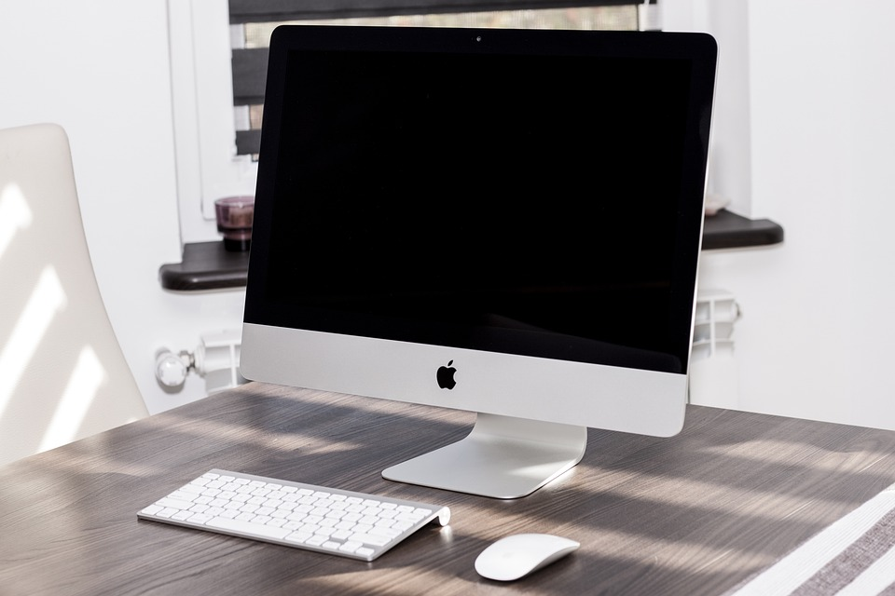
What is computer
Computer is a electronics device which is using for calculation and analyse data or information

Slide 2
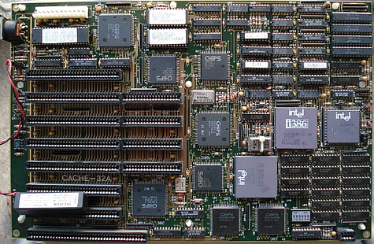
Understanding hardware the physical computers
(Central processing Unit (CPU) …..
The brain of computer responsible for performing calculations and instructions .
Memory (R.A.M)
Temporary storage for data the CPU is actively usuisng allowing for fast access
STORAGE DEVICES
Permanent storage for data such as hard devices , solid –state drives and flash drives

Slide 3


Exploring software ; the instruct ions and programs
Operating system (OS) =the foundation of a computer managing resources and providing and providing a user interface
APPLICATIONS=programs designed to perform specific tasks like word sss
This Photo by Unknown Author is licensed under CC BY

Slide 4
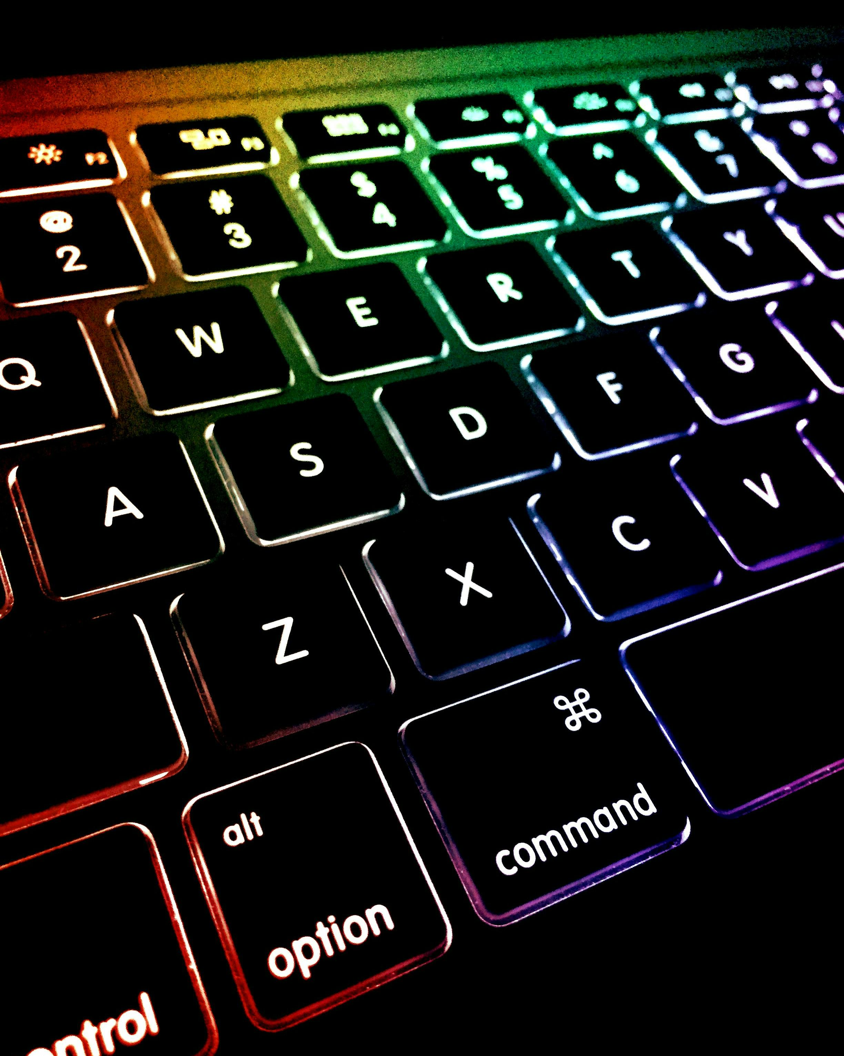
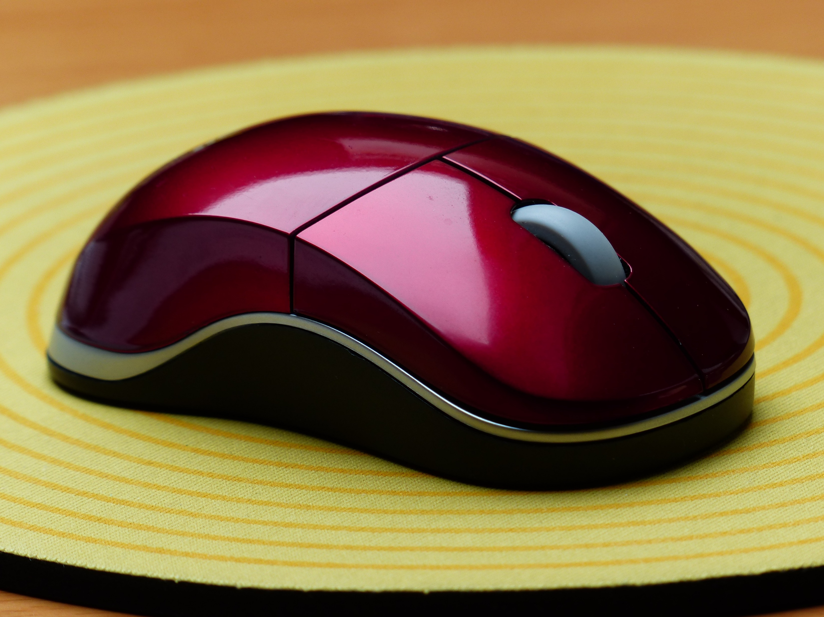
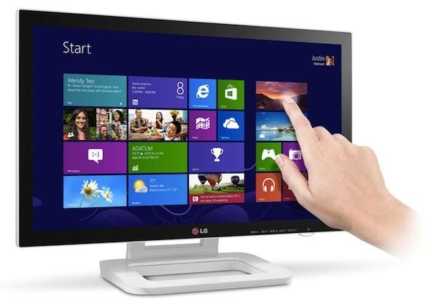
To Input Devices: Communicating with the Compute
Touchscreen
Mouse
Keyboard
Used to enter text, numbers, and
commands
Mouse Used to control the he screen, interact with objects, and navigate menus
Touchscreen Allows for direct interaction with the computer using touch gestures

Slide 5
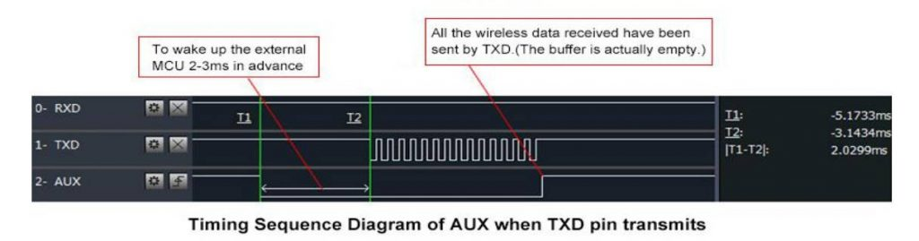
Output Devices: Receiving Information from the Computer
Monitor
Displays visual output, including text, images, and videos
Speakers
Produce audio output, such as music, sound effects, and voice.
Printer
Creates physical copies of documents and images
This Photo by Unknown Author is licensed under CC BY-NC-ND

Slide 6
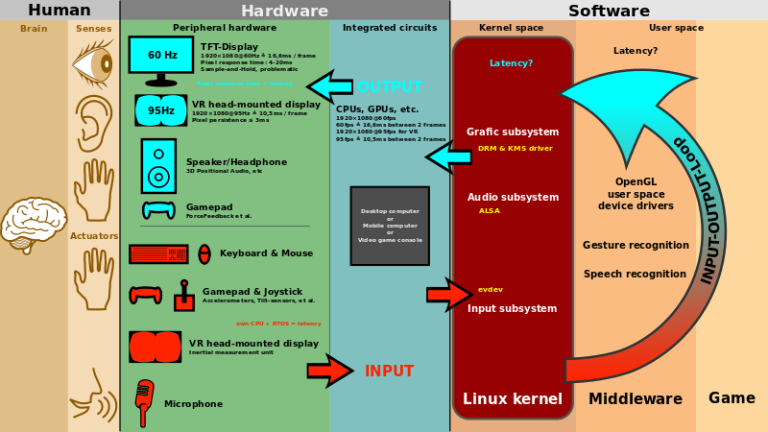
The Relationship Between Hardware and Software
Hardware
Provides the physical components and infrastructure
SOFTWARE
Provides the instructions and programs that tell the hardware what to d
Interaction
Software relies on hardware to function, and hardware is
controlled by software
This Photo by Unknown Author is licensednder CC BY-SA

Slide 7
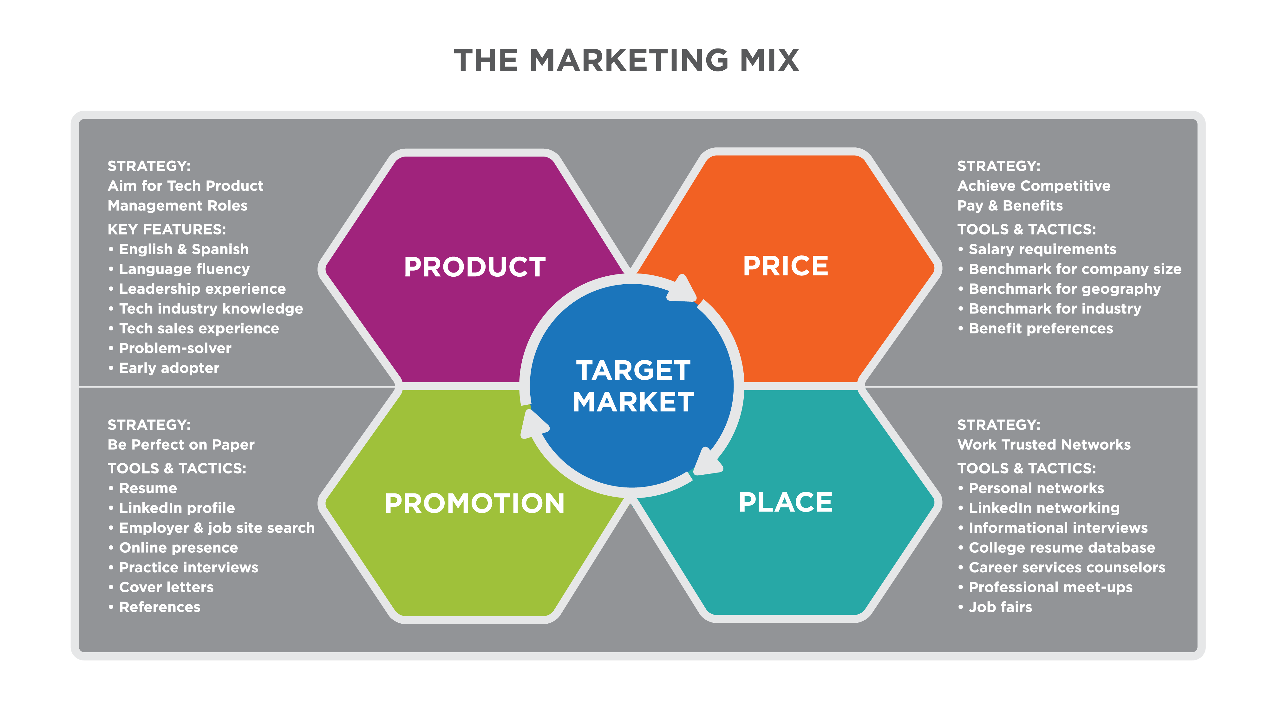
Putting it Together: A Simple Computer System
Information is entered through input devices like the and
2 The CPU interprets and executes instructions from software, manipulating data
4 Storage Data is stored permanently on storage devices for future use
3 Processed information is displayed through output devices like the monitor and speakers
input
output
process
This Photo by Unknown Author is licensed under CC BY

Slide 8

Quiz: Test Your Knowledge
What is the main function of the CPU
What is the difference between RAM and storage
Name two input devices and two output devices.
To process information and execute instructions.
This Photo by Unknown Author is licensed under CC BY-SA-NC

